Slide 1

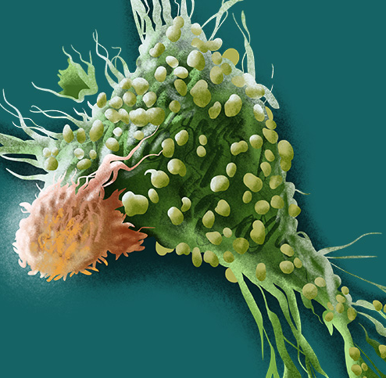
CAR-T CELLS IN DLBCL
Armando Santoro, Stefania Bramanti
Ematologia e Oncologia Medica Humanitas Cancer Center Humanitas Clinical and Research Hospital IRCCS Rozzano (MI)

Slide 2
SCHOLAR-1 study
Retrospective study that analyzed response rate and survival outcome of salvage chemotherapy in R/R DLBCL patients
636 patients with relapsed refractory DLBCL defined as:
no response to 4 cycles of initial chemotherapy or 2 cycles of salvage chemotherapy
or
relapse within 12 months after autologous stem cell transplant (auto-HCT).
ORR 26%; CR 7%; median OS 6.3 months
Mod. da Crump M, et al. Blood 2017; 130: 1800-1808
Notes:
R/R: relapsed or refractory; ORR: overall response rate; CR: complete response; OS: overall survival; DLBCL: diffuse large B-cell lymphoma; HCT: hematocrit

Slide 3
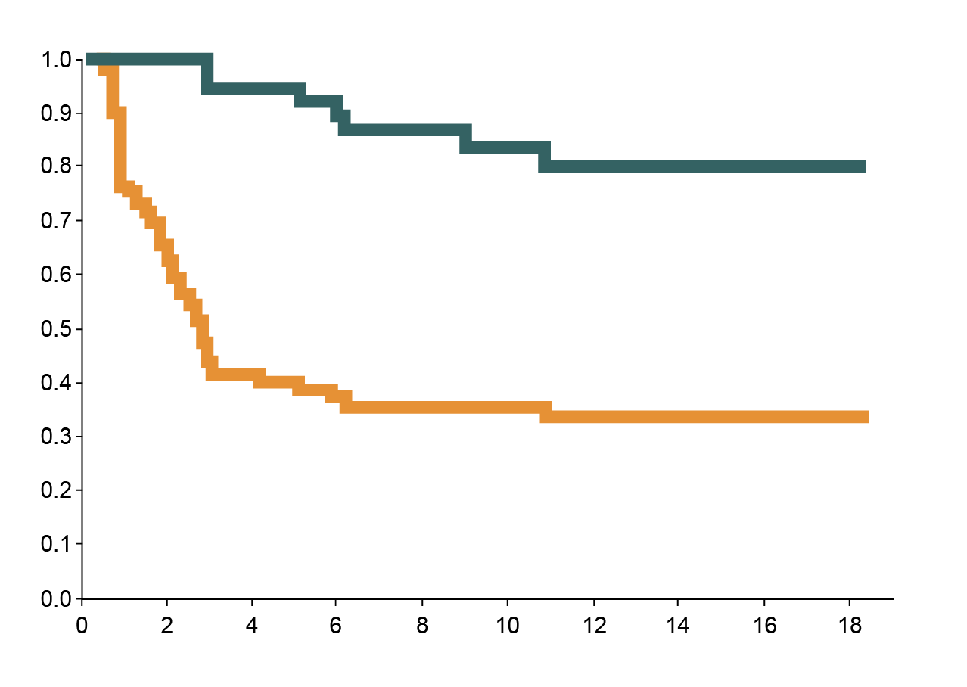
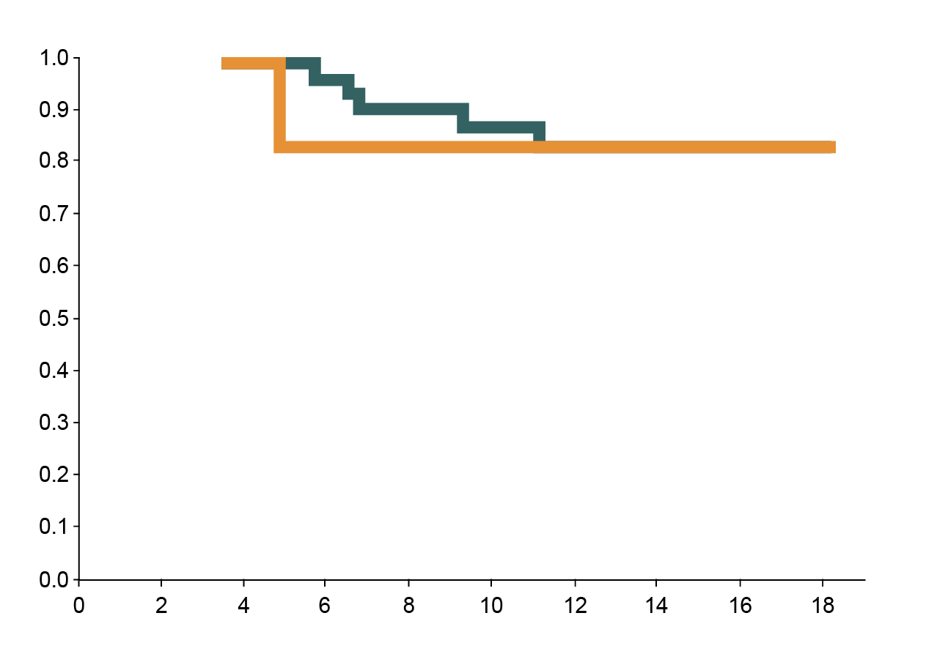
JULIET trial: Tisagenlecleucel
CD19 specific, 41BB containing CAR-T, bulk CD3 cells using a lentiviral vector
N=93 infused: ORR=52%, CR=40%
Grade 3/4 CRS = 22% * U Penn grading; Grade 3/4 NT = 12%
PFS
PFS AMONG PATIENTS WITH A RESPONSE
Probability of Remaining Progression-free
Probability of Remaining Progression-free
Patients with complete response
All patients
Patients with complete response at month 3
Patients with partial response at month 3
Months since infusion
Months since infusion
Mod. da Schuster SJ, et al. NEJM 2019; 380: 45-56
Notes:
CRS: cytokin release syndrome; PFS: progression-free survival

Slide 4
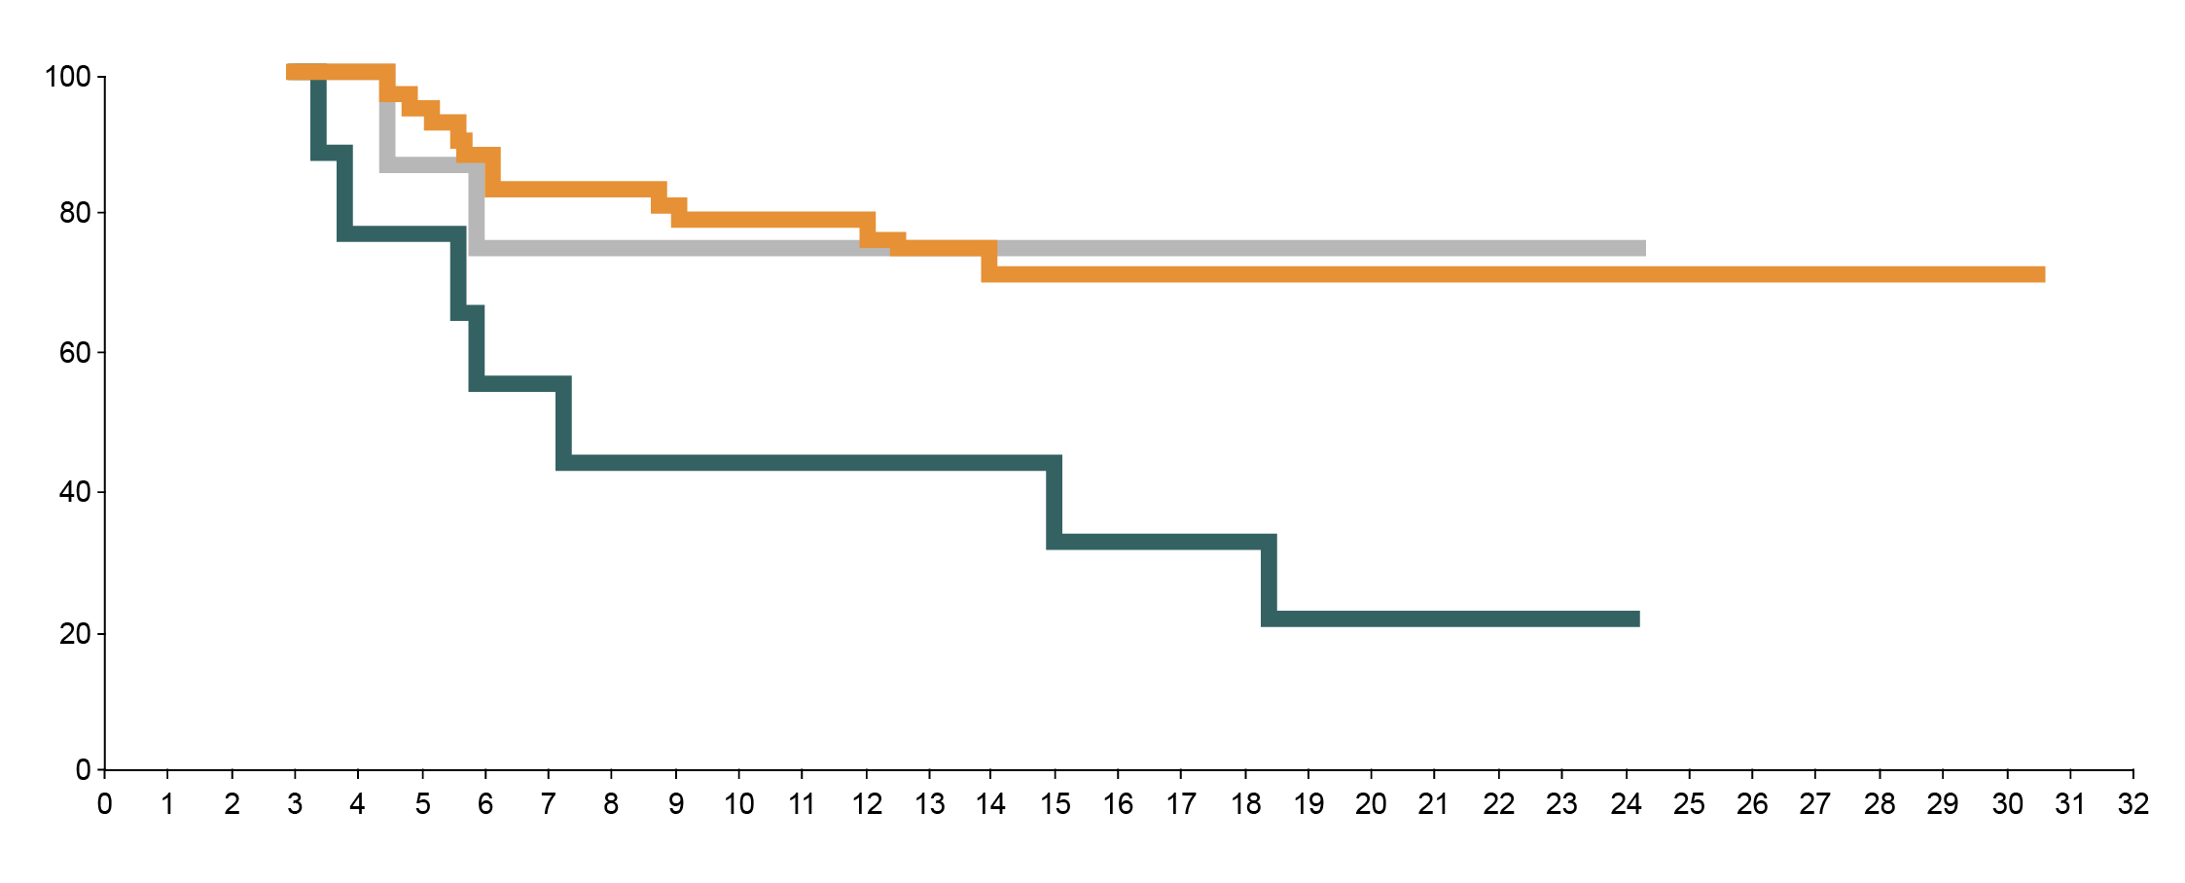
ZUMA-1 trial: Axicabtagene
CD19 specific, CD28 containing CAR-T, bulk CD3 cells using a retroviral vector
111 patients with relapsed refractory DLBCL, transformed FL and PMBCL were enrolled
ORR 83%, CR 58%
Progression-free survival (%)
Median PFS, months (95% CI)
Complete response
Partial response
Stable disease
NR (NE-NE)
NR (4.4 – NE)
7.3 (3.4 – NE)
Time (months)
Mod. da Locke FL, et al. Lancet Oncol 2019; 20: 31-42
Notes:
NR: not reported; NE: not estimable; CI: confidence interval; FL: follicular lymphoma; PMBCL: primary mediastinal B-cell lymphoma

Slide 5
Real-world axi-cel experience: Characteristics of infused patients
Characteristics | N=293
Age, median (range), y | 60 (21-83)
Male, n (%) | 189 (65)
ECOG 0-1, n (%) | 232 (81)
2/3-4 | 44 (15) / 12 (4)
Disease stage III/IV, n (%) | 240 (84)
DLBCL, n (%) | 197 (68)
GCB/ABC, n/N (%) | 151/253 (60) / 102/253 (40)
Double or triple hit/double expressor, n/N (%) | 62/272 (23) / 97/272 (38)
PMBCL/TFL, n (%) | 17 (6) / 75 (26)
IPI ≥ 3, n (%) | 158 (55)
> 3 Prior therapies, n (%) | 215 (75)
Primary refractory, n (%) | 100 (35)
Refractory to 2L or later, n (%) | 121 (42)
Relapsed post-ASCT, n (%) | 95 (33)
124/286° (43%) patients would have been ineligible for ZUMA-1
REASONS FOR ZUMA-1 EXCLUSION
Criteria, n (%) | N=124
Platelets < 75 | 37 (13)
Active DVT/PE | 27 (9)
Prior CD19 CAR-T cell therapy | 24 (8)
GFR < 60 | 22 (8)
History of CNS lymphoma | 22 (8)
Symptomatic pleural effusion | 11 (4)
Ejection fraction < 50% | 10 (4)
Prior alloSCT | 7 (2)
Mod. da Nastoupil LJ, et al. Blood 2018; 132 (suppl_1): 91
Notes:
GCB: germinal center B-cell; ABC: activated B-cell; TFL: transformed follicular lymphoma; IPI: International Prognostic Index; ASCT: autologous stem cell transplantation; DVT: deep vein thrombosis; PE: pulmonary embolism; CNS: central nervous system; GFR: glomerular filtration rate; SCT: stem cell transplantation

Slide 6
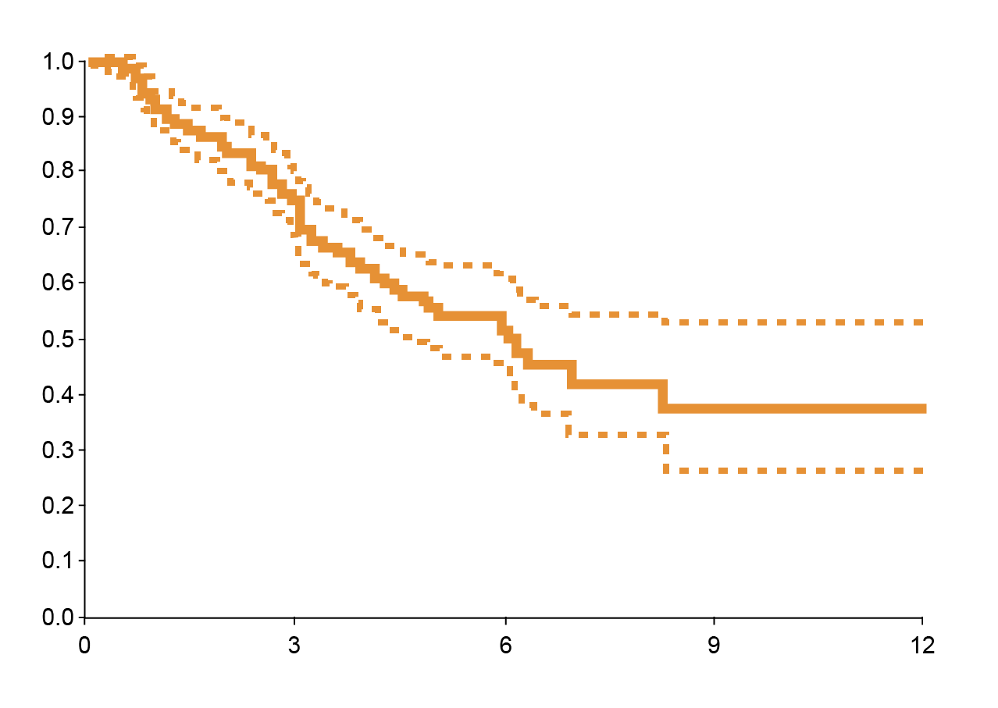
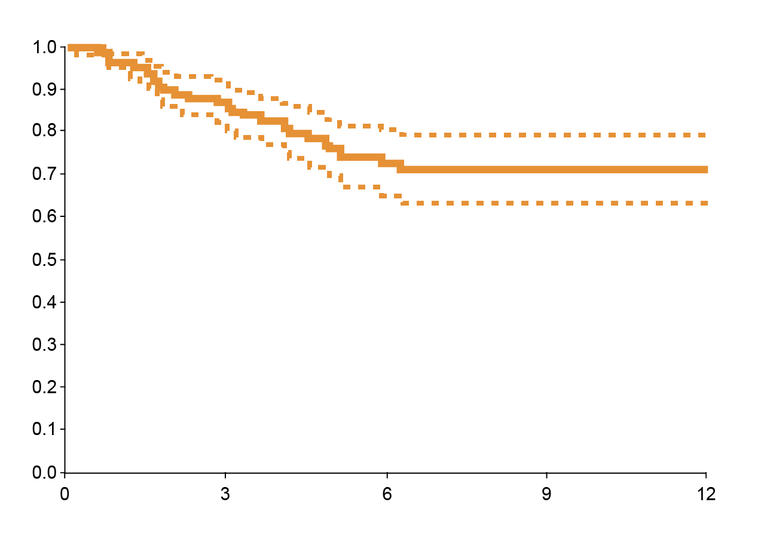
Real-world axi-cel experience: PFS and OS
PROGRESSION-FREE SURVIVAL
OVERALL SURVIVAL
Median PFS time: 6.18 months
95% CI: 4.57 ~ NA months
6 months OS estimate in 72%
(95% CI 65-80%)
Probability
Probability
Time (months)
Time (months)
Mod. da Nastoupil LJ, et al. Blood 2018; 132 (suppl_1): 91

Slide 7
 | JULIET (tisa-cel) | ZUMA-1 (axi-cel) | TRANSCEND NHL 001 (liso-cel)
Company | Novartis | Kite/Gilead | Juno/Celgene
Source | Schuster, NEJM 2019 | Locke, Lancet Oncol 2019 | Abramson, ASH abs 2017
Disease entity | DLBCL, TFL | DLBCL, TFL and PMBCL | DLBCL, HGBCL, TFL (CORE cohort)
Inclusion criteria | ≥2 prior lines of therapies for DLBCL PD after or ineligible for auto SCT | No response to last chemotherapy or Relapse <12 months after ASCT | ≥2 prior lines of therapies
Enrolment | 93 patients evaluable | 108 patients evaluable | CORE cohort: 91 patients evaluated for safety; 65 patients evaluated for efficacy
Patient population | Prior therapies ≥3: 52% 49% ASCT 55% refractory | Prior therapies ≥3: 70% 23% ASCT 74% refractory | Median prior therapies 3 (2–8) 38% ASCT 67% refractory
Efficacy | Median FU 14 months ORR: 52%; CR: 40% 12-month OS: 49% Median OS: CR: NR; all: 11.7 months | Median FU: 24 months ORR: 83%; CR: 58% Median OS months: NR | ORR: 80%; CR: 59% 12-month OS: 63% Median OS: CR: NR; PR 10.3 months
Mod. da Nastoupil LJ, et al. Blood 2018; 132 (suppl_1): 91
Notes:
PD: progressive disease; HGBCL: high grade B-cell lymphoma; PR: partial response

